Slide 1
FP (Frequent pattern)-growth algorithm
Elektrotehnički fakultet Univerziteta u Beogradu
ERTAN LJAJIĆ, 3392/2013

Slide 2
FP-growth algorithm
The FP-Growth algorithm is one of the association rule learning algorithms
The FP-Growth Algorithm is an alternative way to find frequent itemsets without generation of candidates (in a priori algorithms), thus improving performance
Two step approach:
Step 1: Build a compact data structure called the FP-tree (Frequent Pattern tree)
Step 2: Use a recursive divide-and-conquer approach to extract the frequent itemsets directly from the FP-tree

Slide 3
DefinitionS AND FORMULAS
Itemset
A collection of one or more items.
Example: {B, C, D}
k-itemset
An itemset that contains k items
Support count (σ)
Frequency of occurrence of an itemset
Set of all items in a market basket data I = {i₁, i₂, ..., iₐ}
Set of all transactions T = {t₁, t₂, ..., tₓ}
Support count σ(X) fot itemset X: σ(X) = |{t¡|X$⊆,\text{t}\text{¡}∈T\}|$
EXAMPLE: σ({A, B, C}) = 3

Slide 4
DefinitionS AND FORMULAS
Support
HOW OFTEN A RULE (X$→Y)$IS APPLICABLE TO A GIVEN DATA SET
N – NUMBER OF TRANSACTIONS
CONFIDENCE
HOW FREQUENTLY ITEMS IN Y APPEAR IN TRANSACTIONS THAT CONTAIN X
Frequent Itemset
An itemset whose support is greater than or equal to a minsup threshold

Slide 5
FP-tree construction
null
After reading TID=2:
After reading TID=1:
null
A:1
A:1
B:1
B:1
B:1
C:1
After reading TID=3:
D:1
null
B:1
A:2
B:1
C:1
C:1
D:1
D:1
E:1

Slide 6
FP-tree construction
The data set is scanned once to determine the support count of each item. Infrequent items are discarded, while the frequent items are sorted in decreasing support counts.
After reading the ﬁrst transaction, {a, b}, the nodes labeled as a and b are created. A path is then formed from null —> a —> b to encode the transaction. Every node along the path has a frequency count of 1.
After reading the second transaction, {b, c, d}, a new set of nodes is created for items b, c, and d. A new path is then formed. Every node along this path also has a frequency count equal to one.
The third transaction, {a, c, d, e}, shares a common preﬁx item (which is a) with the ﬁrst transaction. As a result, the path for the third transaction, null —> a —> c —> d —> e, overlaps with the path for the ﬁrst transaction, null —> a —> b. Because of their overlapping path, the frequency count for node a. is incremented to two
This process continues until every transaction has been mapped onto one of the paths given in the FP-tree.

Slide 7
FP-tree construction
Transaction Database
null
A:8
B:2
B:5
C:2
C:1
D:1
D:1
C:3
D:1
E:1
D:1
E:1
E:1
D:1
After reading TID=10

Slide 8
FP-growth algorithm
FP-growth algorithm generates frequent itemsets from an FP-tree by exploring the tree in a bottom-up fashion - from the leaves towards the root
Given the example tree, the algorithm looks for frequent itemsets ending in e ﬁrst, followed by d, c, b, and ﬁnally, a
Since every transaction is mapped onto a path in the FP-tree, we can derive the frequent itemsets ending with a particular item
Divide-and-conquer strategy to split the problem into smaller sub problems: first look for frequent itemsets ending in e, then de, etc. . . then d, then cd, etc. . .
For example, suppose we are interested in FInding all frequent itemsets ending in e

Slide 9
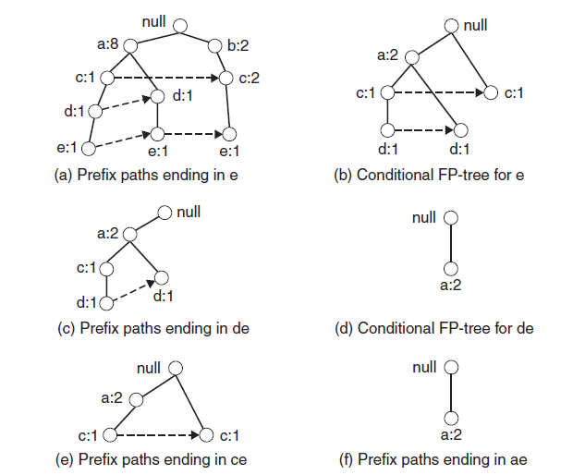
FP-growth algorithm
Frequent itemsets ending with e: {e}, {d, e}, {a,d,e}, {c,e}, {a,e}

Slide 10
FP-growth algorithm
The ﬁrst step is to gather all the paths containing node e.
Assuming that the minimum support count is 2, {e} is declared a frequent itemset because its support count is 3.
Because {e} is frequent, the algorithm has to solve the subproblems of ﬁnding frequent itemsets ending in dc, ce, be, and ac. It must ﬁrst convert the preﬁx paths into a conditional FP-tree:
The support counts along the preﬁx paths must be updated. For example, the rightmost path shown in Figure (a), null —> b:2 —> c:2 —> e:1, includes a transaction {b, c} that does not contain item e. The counts along the preﬁx path must therefore be adjusted to 1 to reﬂect the actual number of transactions containing {b, c, e}.
The preﬁx paths are truncated by removing the nodes for e. These nodes can be removal because the support counts along the preﬁx paths have been updated to reﬂect only transactions that contain e
After updating the support counts along the preﬁx paths, some of the items may no longer be frequent. For example, the node b appears only once and has a support count equal to 1, which means that there is only one transaction that contains both b and e
FP-Growth uses the conditional FP-tree for e to solve the subproblems of ﬁnding frequent itemsets ending in dc, ce, and ae

Slide 11
FP-growth algorithm
After we found frequent itemsets ending with e, similarly we can find frequent itemsets ending with d, c, b and finally, a.
The list of frequent itemsets ordered by their corresponding suffixes
Suffix | Frequent Itemset
e | {e}, {d, e}, {a,d,e}, {c,e},{a,e}
d | {d}, {c,d}, {b,c,d}, {a,c,d}, {b,d}, {a,b,d}, {a,d}
c | {c}, {b,c}, {a,b,c}, {a,c}
b | {b}, {a,b}
a | {a}

Slide 12
FP-growth memory consumption?

Slide 13
conclusions
FP-tree: a novel data structure storing compressed, crucial information about frequent patterns, compact yet complete for frequent pattern mining
FP-growth: an efficient mining method of frequent patterns in large Database: using a highly compact FP-tree, divide-and-conquer method in nature
Advantages of FP-Growth
only 2 passes over data-set
“compresses” data-set
no candidate generation
outperforms Apriori Algorithm
Disadvantages of FP-Growth
FP-Tree may not fit in memory
FP-Tree is expensive to build
Parameter | Apriori Algorithm | FP-growth Algorithm
Technique | Use Apriori property and join and prune property | It constructs conditional frequent pattern tree and conditional pattern base from database which satisfy minimum support.
No. of scans | Multiple scans for generating candidate sets. | Scan the DR only twice and twice only.
Time | Execution time is more as time is wasted in producing candidates every time. | Execution time is small than Apriori algorithm.

Slide 14
References
Pang-Ning Tan, Michael Steinbach, Vipin Kumar: Introduction to Data Mining, Addison-Wesley, godina izdavanja
-, Data Mining Algorithms In R/Frequent Pattern Mining: The FP-Growth Algorithm, http://en.wikibooks.org, 11.12.2013.

Slide 15
Unless... you have any question?

